Slide 1
find Command
Supports searching by file, folder name, creation date, modification date, owner and permissions
Find a file based on its name: find -name one.txt
Find all files with extension .txt: find -type f -name "*.txt"
Find all .txt files that contain the word test: find -type f -name "*.txt" -exec grep "test" {} \;
Find all files with extension txt, pdf, or c: find ./ -type f -name "*.txt" -o -name "*.pdf" -o -name "*.c“
Rename all .txt files to .pdf: find . -depth -name "*.txt" -exec sh -c 'f="{}"; mv -- "$f" "${f%.txt}.pdf"' \;

Slide 2
Past Lab Exam Question
Write a bash script to take input string from user. Print output as follows.
a) If all the characters in input string is upper case, print “Input String is in UPPER case”
b) If all the characters in input string is lower case, print “Input String is in LOWER case”
c) else print “Input String is in MIXED case”

Slide 3
Past Lab Exam Question
Note: Some shells allow the = operator to be used for string comparison instead of ==, but it is not recommended.
We should use = for assignment and == for comparison.
Example:
my_variable="Hello"
and
if [ "$string1" == "$string2" ]; then
echo "Strings are equal.“
fi
#!/bin/bash
echo "Please enter a string: "
read input
# Check if the input is all uppercase
if [[ $input == [A-Z]* ]]; then
echo "The input is in all uppercase."
# Check if the input is all lowercase
elif [[ $input == [a-z]* ]]; then
echo "The input is in all lowercase."
# If it's not all uppercase or all lowercase, it must be mixed case
else
echo "The input is in mixed case."
fi

Slide 4
Past Lab Exam Question
Write a bash script to take input Number as upper limit from user.
a) Print the PID of the current script
b) Print the Numbers in reverse till we reach zero
e.g: If the user enters 5, print the numbers as below in separate lines
5
4
3
2
1
c) Input Number range is greater than 1 and less than 100
d) If user inputs number less than 1 or more than 100 print message “Input Number is Out of range”

Slide 5
Past Lab Exam Question
$$ is a special shell variable that represents the PID of the current running script
#!/bin/bash
echo "Enter the upper limit:"
read num
if [ $num -lt 1 ] || [ $num -gt 100 ]
then
echo "Input Number is Out of range"
else
echo "PID of the current script: $$"
for (( i=$num; i>=1; i-- ))
do
echo $i
done
fi

Slide 6
Past Lab Exam Question
Write a bash script to take two input string from user. Print the output as follows
a) If the input string 1 and input String 2 matches, Print “The TWO STRING matches”. The match should not be case sensitive. Means Input String 1 is “SPARK” and input 2 string is “Spark”, still it should print “The TWO STRING matches”.
b) If the input string 1 and input String 2 does not match, Print “The TWO STRING DOES NOT match”

Slide 7
Past Lab Exam Question
#!/bin/bash
echo "Enter the first string:"
read str1
echo "Enter the second string:"
read str2
if [ "${str1,,}" == "${str2,,}" ]
then
echo "The TWO STRINGS MATCH"
else
echo "The TWO STRINGS DO NOT MATCH"
fi
"${str1,,}": converts the string to lowercase
==: checks if two strings are equal
"${input^^}“: converts the string to uppercase

Slide 8
Past Lab Exam Question: Another Solution for the Same Problem
#!/bin/bash
echo "Enter the first string:"
read string1
echo "Enter the second string:"
read string2
# Convert both strings to lowercase and compare
lowercase_string1=$(echo "$string1" | tr '[:upper:]' '[:lower:]')
lowercase_string2=$(echo "$string2" | tr '[:upper:]' '[:lower:]')
if [ "$lowercase_string1" == "$lowercase_string2" ]; then
echo "The strings are equal (case-insensitive)."
else
echo "The strings are not equal (case-insensitive)."
fi

Slide 9
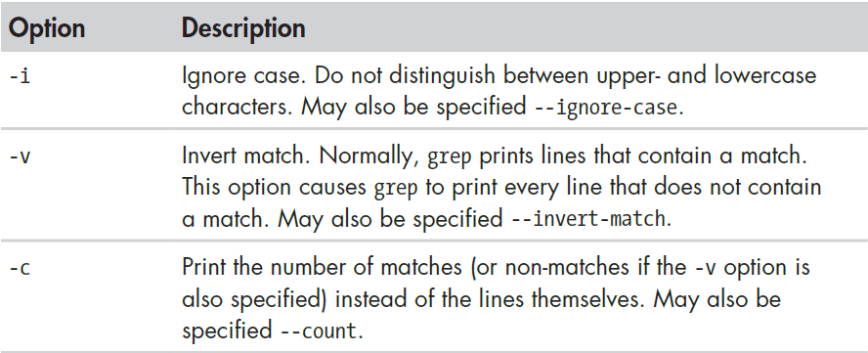
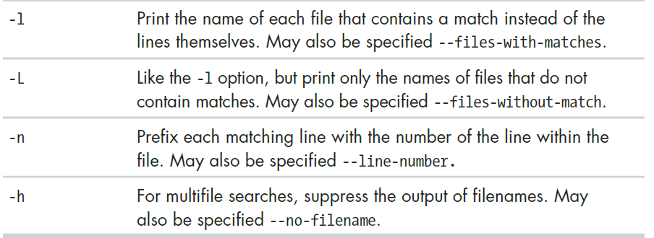
grep – Searching through text
grep searches text files for the occurrence of a specified regular expression and outputs any line containing a match to standard output.
Has many options
grep PATTERN file
e.g. grep “tiger” animals.txt

Slide 10
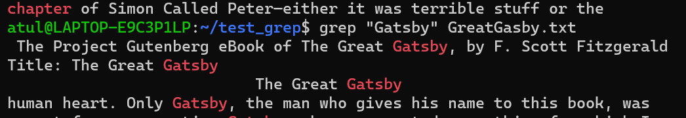
Another Example
Create a test_grep directory in home/<user name> directory (e.g. /home/atul/test_grep
Create a file GreatGatsby.txt in home/atul/test_grep directory (Available at https://www.gutenberg.org/cache/epub/64317/pg64317.txt)
grep “chapter” GreatGatsby.txt
grep “Gatsby” GreatGatsby.txt
… and many more lines

Slide 11
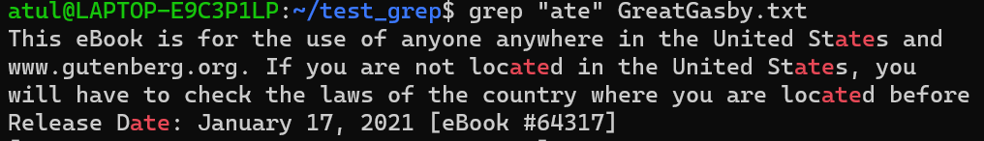
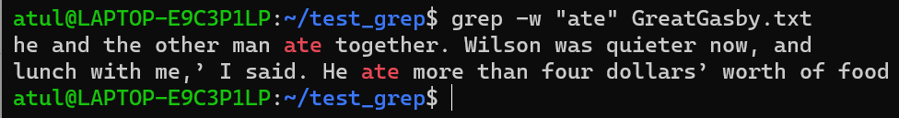
More Examples
grep “ate” GreatGatsby.txt
Shows all occurrences of the word ate, including text inside other words
To restrict to whole words only:
grep -w “ate” GreatGatsby.txt

Slide 12
More grep Examples
grep three file1 -> Show all lines having three in file1
grep t file1
grep -v t file1 -> Show all lines not having t in file1
grep -n t file1 -> Line numbers
grep -c t file1 -> Count of t
grep -e t -e f file1 -> Multiple patterns
grep [tf] file1 -> Same as above

Slide 13
Create this file
unix is great os. unix is opensource. unix is free os.
learn operating system.
Unix linux which one you choose.
uNix is easy to learn.unix is a multiuser os.Learn unix .unix is powerful.

Slide 14
Try these Commands
grep -i "UNix" geekfile.txt -> Case insensitive search
grep -c "unix" geekfile.txt -> Count of matching lines
grep -l "unix" * -> Files containing the given string
grep -w "unix" geekfile.txt -> Match whole word unix
grep -o "unix" geekfile.txt -> Display only the matching pattern, not the whole string
grep -n "unix" geekfile.txt -> Show lines numbers of matching lines
grep -v "unix" geekfile.txt -> Invert the search pattern
grep "^unix" geekfile.txt -> Match lines starting with this string
grep "os$" geekfile.txt -> Match lines ending with this string

Slide 15
Past Exam Question
Count the number of lines in file “cdac-sylabus.txt” which has word “JAVA” in that line.
Note: The word should not have any prefix or suffix. Eg “EBJAVA” or “JAVAB” should be excluded while getting the counts for “JAVA”
grep -c "\<JAVA\>" "cdac-syllabus.txt"

Slide 16
sed
Stream editor, as opposed to a normal interactive editor
It is a text editor without an interface. You can use it from the command line to manipulate text in files and streams.
With sed you can do all of the following:
Select text
Substitute text
Add lines to text
Delete lines from text
Modify (or preserve) an original file

Slide 17
sed Example
echo "This is a test" | sed 's/test/big test/’
The echo command sends “This is a test” into sed using pipe symbol
The simple substitution rule (s = substitute) is applied
sed searches the input text for an occurrence of the first string (test) and replaces with the second (big test)
Output will be sent to the terminal window

Slide 18
sed Examples
Note: File contents are not changed, only output is changed.
Create python.txt
Python is a very popular language.
Python is easy to use. Python is easy to learn.
Python is a cross-platform language
sed '2 s/Python/perl/g' python.txt → Replacement in the second line, g means all the instances in that line (here, 2)
sed 's/Python/perl/g2' python.txt → Replace the second occurrence on every line, wherever there is a match
sed '1 s/Python/perl/' python.txt → Replace the first occurrence on the first line
sed '$s/Python/Bash/' python.txt → Replace the last line’s first occurrence

Slide 19
sed and Delete
Create os.txt
Windows
Linux
Android
OS
sed '/OS/d' os.txt → Delete lines containing the word OS
sed '/Linux/,+2d' os.txt → Delete line containing the word Linux and next two lines

Slide 20
sed and Insert
Create myfile
This is a test and I like this test.
This is the next line of the test script.
sed '2i\This is the inserted line.' myfile → Insert a new second line
sed '2a\This is the appended line.' myfile → Append a new line (Note the position of the new line)
i is before and a is after

Slide 21
View a Range of Lines
Create sedtest.txt
This is a demo text file.
It is an amazing file that will help us all.
The sed command is also great for stream editing.
Want to learn how to use the command?
This is another line in the file.
This is the third general line in the file.
This file is named as textfile.
This is a apple.
This is a orange.
sed -n '3,5p' sedtest.txt => Display lines between 3 and 5
sed '3,5p' sedtest.txt => Display lines between 3 and 5
sed ‘3,5d' sedtest.txt => Display lines other than between 3 and 5
The -n flag prevents sed from displaying the pattern space at the end of each cycle.
The p argument stands for print and is used to display the matched lines to the user.
The d flag deletes the matched strings from the output and displays the rest of the content.

Slide 22
sed | More Examples
sed -n -e '1,2p' -e '5,6p' sedtest.txt => Display non-consecutive lines
The -e flag helps in executing multiple actions using a single command.
sed s/originalword/replaceword/g filename => Replace something
sed s/amazing/super/g sedtest.txt
The s argument denotes substitution and the g command is used to replace the matched content with the specified replacement content.

Slide 23
sed | More Examples
sed '2,5s/This/That/g’ sedtest.txt => Substitute words in a range of lines (2 to 5 in this example)
sed 's/amazing/super/g;s/command/utility/gi' textfile.txt => Multiple substitutions
sed -e '/orange/ s/a/an/g’ sedtest.txt
Replace the word a with an if the word orange is present in the line

Slide 24
Adding Users
The useradd and adduser command
Example: sudo useradd cdac
To allow the new user to login, we must set a password for the new user
Example: sudo passwd cdac
On some Linux distributions, the new user’s home directory is not automatically created, in which case, we need to use the following syntax
sudo useradd -m cdac
On Ubuntu, we can use a different command: sudo adduser cdac and to give the user admin privileges, sudo usermod -aG sudo cdac

Slide 25
Removing Users
The userdel and deluser command
Example: sudo deluser cdac
On Ubuntu, we can use a different command: sudo userdel cdac

Slide 26
Changing File Ownership
The chown command
Change the user and/or group ownership of a given file or directory
Example: sudo chown cdac test.txt
Verify by using the ls -l command

Slide 27
Counting Number of Lines in a File, etc
The word count (wc) command
Find out number of lines, words, bytes and characters in a file
Create two files: state.txt and capital.txt
Andhra Pradesh
Arunachal Pradesh
Assam
Bihar
Chhattisgarh
Amaravati
Itanagar
Dispur
Patna
Raipur

Slide 28
Counting Number of Lines in a File, etc
Andhra Pradesh
Arunachal Pradesh
Assam
Bihar
Chhattisgarh
wc state.txt
5 7 58 state.txt
wc state.txt capital.txt
5 7 58 state.txt
5 5 39 capital.txt
10 12 97 total
wc -l state.txt
5 state.txt
wc -w state.txt capital.txt
7 state.txt
5 capital.txt
12 total
Number of lines
Amaravati
Itanagar
Dispur
Patna
Raipur
Number of words

Slide 29
Counting Number of Lines in a File, etc
wc -c state.txt
58 state.txt
ls | wc -l
17
Andhra Pradesh
Arunachal Pradesh
Assam
Bihar
Chhattisgarh
Number of bytes
Number of files and directories in the current directory
Amaravati
Itanagar
Dispur
Patna
Raipur

Slide 30
Past Lab Exam Questions
Convert all file names from upper case to lower case
for i in $( ls | grep [A-Z] ); do mv -i $i `echo $i | tr 'A-Z' 'a-z'`; done
Convert all file names from upper case to lower case and change .txt extension to .pdf
for i in $( ls | grep [A-Z] ); do mv -i $i `echo $i | tr 'A-Z' 'a-z'`; done | find . -depth -name "*.txt" -exec sh -c 'f="{}"; mv -- "$f" "${f%.txt}.pdf“’ \;
Alternative: Bash script – See next slide

Slide 31
Another solution
#!/bin/bash
echo "Enter the folder path:"
read folder_path
for file in "$folder_path"/*.txt; do
if [[ -f "$file" ]]; then
filename=$(basename -- "$file")
extension="${filename##*.}"
filename="${filename%.*}"
new_filename="${filename^^}.UPC"
mv -- "$file" "$folder_path/$new_filename"
fi
done

Slide 32
Past Lab Exam Question
What are the command to perform below tasks:
a) Rename a file from “application.jsp” to “application.html”
b) Find a process running with PID “2391”
c) Print the first 15 lines from file “content.txt”
d) Find files with name “java.cpp” within current folder or its subfolders
e) Create group as “tester”

Slide 33
Past Lab Exam Question
mv application.jsp application.html
ps -p 2391
head -n 15 content.txt
find . -name "java.cpp"
sudo groupadd tester

Slide 34
FTP, Telnet, etc

Slide 35
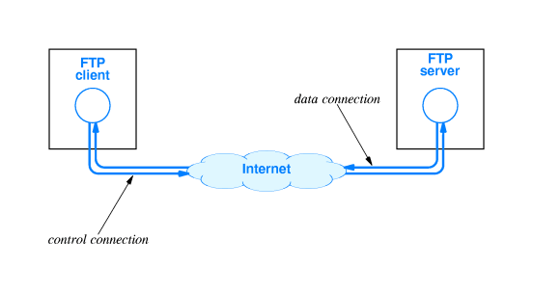
FTP Concept

Slide 36
FTP (File Transfer Protocol)
One of the earliest Internet protocols for file transfers
Allows downloading (server-to-client) or uploading (client-to-server) of files remotely
Made up of two parts
FTP server: Has files that can be downloaded, or it can also receive files from the users
FTP client: Downloads the require files from an FTP server, or it can upload files to the FTP server also

Slide 37
Setting up FTP Server on Ubuntu (on VirtualBox)
Step 1: A common open-source FTP utility used in Ubuntu is vsftpd.
sudo apt install vsftpd
Step 2: Start the FTP server
sudo systemctl start vsftpd
Step 3: Backup configuration files for safety
sudo cp /etc/vsftpd.conf /etc/vsftpd.conf_default

Slide 38
Setting up FTP Server on Ubuntu
Step 4: Create an FTP user, so that a client can access the FTP server
sudo useradd -m testuser
sudo passwd testuser
Step 5: Allow FTP through the firewall
sudo ufw allow 20/tcp
sudo ufw allow 21/tcp
Step 6: Connect to the FTP server locally
sudo ftp Ubuntu
(Here, Ubuntu is considered to be our Linux machine name, so replace it with the actual machine name)

Slide 39
Accessing the FTP Server from our Windows Machine
Open command prompt and type ftp
ftp> open
To 192.168.0.24 … This is the IP address of the Ubuntu machine – to find it, we can type ip a or ifconfig on the Ubuntu machine’s terminal
Connected to 192.168.0.24.
220 (vsFTPd 3.0.5)
200 Always in UTF8 mode.
User (192.168.0.24:(none)): testuser
331 Please specify the password.
Password:
230 Login successful.

Slide 40
Accessing the FTP Server from our Windows Machine
ftp> stat
Connected to 192.168.0.24.
Type: ascii; Verbose: On ; Bell: Off ; Prompting: On ; Globbing: On
Debugging: Off ; Hash mark printing: Off .
ftp> pwd
257 "/home/testuser" is the current directory
ftp> dir

Slide 41
Checking for Files
Create a file on the FTP server (i.e. Ubuntu machine)
atul@atul-virtualbox:~$ sudo su
root@atul-virtualbox:/home/atul# cd /home/testuser/
root@atul-virtualbox:/home/testuser# nano test.txt

Slide 42
Now Check in Windows FTP Client
ftp> pwd
257 "/home/testuser" is the current directory
ftp> dir
200 PORT command successful. Consider using PASV.
150 Here comes the directory listing.
-rw-r--r-- 1 0 0 14 Mar 23 19:10 test.txt
226 Directory send OK.
ftp: 69 bytes received in 0.01Seconds 8.63Kbytes/sec.

Slide 43
Download a File using FTP
ftp> get test.txt
200 PORT command successful. Consider using PASV.
150 Opening BINARY mode data connection for test.txt (14 bytes).
226 Transfer complete.
ftp: 14 bytes received in 0.00Seconds 14000.00Kbytes/sec.

Slide 44
Telnet and SSH
Telnet (Terminal + Network) is an Internet protocol for allowing a client computer to connect to a remote server computer and work on the server computer
Somewhat obsolete (outdated)
Now we generally use SSH (Secure Shell) instead of Telnet
SSH also allows a remote client computer to connect to a server over the Internet
Very useful in cloud computing

Slide 45
Setting up Telnet Server on Ubuntu
Step 1: Install Telnet server
sudo apt install telnetd -y
Step 2: Check the Telnet status
sudo systemctl status inetd
Step 3: Configure firewall for Telnet
sudo ufw enable
sudo ufw allow 23
Step 4: Test
telnet 192.168.0.24

Slide 46
Accessing Telnet from Windows
On the command prompt, type telnet
If you get an error, search for Turn Windows Features On/Off and enable Telnet there, then retry telnet
On the telnet prompt, o 192.168.0.24
User id: testuser, Password: testuser

Slide 47
Setting up SSH on Ubuntu Server
Step 1: Install SSH server
sudo apt install openssh-server
Step 2: Check the SSH status
sudo systemctl status ssh
Step 3: Configure firewall for SSH
sudo ufw allow ssh
Step 4: Restart if necessary
sudo service ssh restart

Slide 48
Access SSH using Putty
Download and install Putty (https://www.putty.org/)
Open Putty, enter IP address as 192.168.0.24 and connect
User id: testuser, Password: testuser

Slide 49
Deadlocks

Slide 50
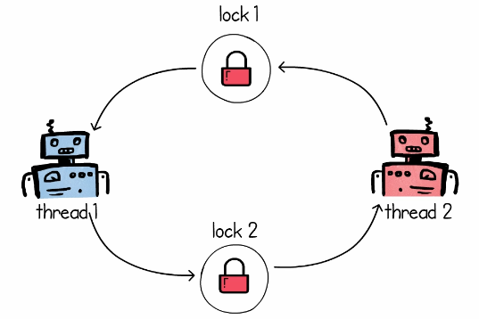
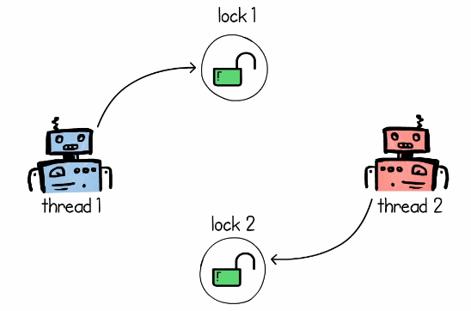
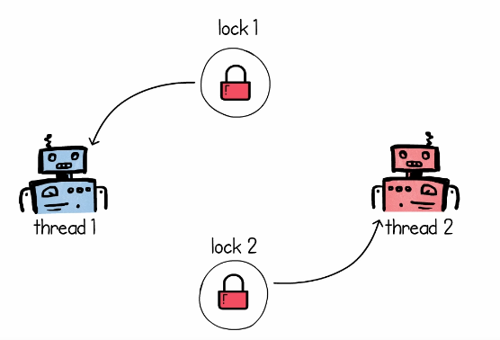
Deadlock
Step 1: Thread 1 asks for Lock 1 on resource R1, Thread 2 asks for Lock 2 on resource R2 – both are successful
Step 2: Soon after, they want a lock on the resource that the other thread has locked
Result: Deadlock

Slide 51
Deadlock Example: C:\lectures\CDAC\DAC\deadlock.py
from threading import Thread, Lock
import time
def red_robot(lock1, lock2):
while True:
print("Red: Acquiring lock 1...")
lock1.acquire()
print("Red: Acquiring lock 2...")
lock2.acquire()
print("Red: Locks acquired...")
lock1.release()
lock2.release()
print("Red: Locks released")
time.sleep(0.5)
def blue_robot(lock1, lock2):
while True:
print("Blue: Acquiring lock 2...")
lock2.acquire()
print("Blue: Acquiring lock 1...")
lock1.acquire()
print("Blue: Locks acquired...")
lock1.release()
lock2.release()
print("Blue: Locks released")
time.sleep(0.5)
mutex1 = Lock()
mutex2 = Lock()
red = Thread(target=red_robot, args=(mutex1, mutex2))
blue = Thread(target=blue_robot, args=(mutex1, mutex2))
red.start()
blue.start()

Slide 52
Four Simultaneous Necessary Conditions for a Deadlock
Mutual exclusion. Only one process can use a resource.
Hold and wait. A process must be holding at least one resource and waiting to acquire additional resources that are currently being held by other processes.
No preemption. Resources cannot be preempted; that is, a resource can be released only voluntarily by the process holding it.
Circular wait. A set {P0, P1, ..., Pn} of waiting processes must exist such that P0 is waiting for a resource held by P1, P1 is waiting for a resource held by P2, ..., Pn−1 is waiting for a resource held by Pn, and Pn is waiting for a resource held by P0.

Slide 53
Deadlock Prevention and Avoidance
To ensure that deadlocks never occur, the system can use either a deadlock prevention or a deadlock avoidance scheme.
Deadlock prevention: Never allow all the four deadlock conditions to become true
Deadlock avoidance: Allocate resources to only one process at a time

Slide 54
Deadlock Prevention
To prevent a deadlock, we need to examine the four necessary conditions for it and see what can be done

Slide 55
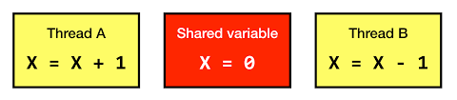
Deadlock Prevention
Condition 1: Mutual exclusion
For a deadlock to occur, at least one resource must be non-sharable (i.e. mutual exclusion condition must become true).
Consider a read-only file – it is sharable – processes do not require an exclusive lock on it.
However, how can we practically mandate that all the resources be sharable?
Hence, avoiding mutual exclusion is very difficult.

Slide 56
Deadlock Prevention
Condition 2: Hold and wait
Whenever a process requests a resource, it does not hold any other resources. Two approaches can be used to handle this:
Each process must request and be allocated all its resources before it begins execution.
Allow a process to request resources only when it has none.
Main disadvantages.
Resource utilization may be low, since resources may be allocated but unused for a long period.
Starvation is possible. A process that needs several popular resources may have to wait indefinitely, because at least one of the resources that it needs is always allocated to some other process.

Slide 57
Deadlock Prevention
Condition 3: No pre-emption
If a process is holding some resources and requests another resource that cannot be immediately allocated to it, then all resources the process is currently holding are preempted.
In other words, these resources are implicitly released.
The process will be restarted only when it can regain its old resources, as well as the new ones that it is requesting.
This protocol is often applied to resources whose state can be easily saved and restored later, such as CPU registers and memory space.

Slide 58
Deadlock Prevention
Condition 4: Circular wait
Impose a total ordering of all resource types and to require that each process requests resources in an increasing order of enumeration.
Suppose our numbering for resources is Tape drive = 1, Disk drive = 5, Printer = 12.
Now a process that needs the tape drive and the printer at the same time must first request the tape drive and then the printer.

Slide 59
Deadlock Avoidance
Here, we require additional information about how resources are to be requested.
For example, in a system with one tape drive and one printer, the system might need to know that process P will request first the tape drive and then the printer before releasing both resources, whereas process Q will request first the printer and then the tape drive.
With this knowledge of the complete sequence of requests and releases for each process, the system can decide for each request whether or not the process should wait in order to avoid a possible future deadlock.
Each request requires that in making this decision the system consider the resources currently available, the resources currently allocated to each process, and the future requests and releases of each process.

Slide 60
Semaphore
Semaphore is a variable that is used to control access to a common resource
It keeps a count of resource usage and decides if the resource can be made available to a requesting process
Two types
Counting semaphore: Can be any number
Binary semaphore: Semaphore with a value of 0 or 1 only

Slide 61
Semaphore Example
A library has 10 copies of a book
One copy can be used by one student at any given time
A student must request the librarian to issue a book copy
If no copy is available, the student must wait till another student returns her copy
When a student finishes using a copy, the student must return the copy to the librarian
This situation can be modelled by using a semaphore

Slide 62
Semaphore – Key Points
A semaphore only tracks the count of free resources – it does not keep a track of which resources are free
If we use binary semaphore then we only want to know if a resource is free (semaphore = 0) or in use (semaphore = 1)
The Producer-Consumer Problem can be solved using semaphores
It is not a locking mechanism – It is a signalling mechanism
Threads and processes perform wait() and signal() operations to indicate whether they are acquiring or releasing resources

Slide 63
Mutual Exclusion (Mutex)
Mutual Exclusion (Mutex) is an object that allows multiple program threads to share the same resource, such as a file, but not simultaneously
Mutex is different from semaphores
Semaphore is a signaling mechanism, mutex is a locking mechanism
Semaphore may or may not be binary, mutex is always binary
Example follows …

Slide 64
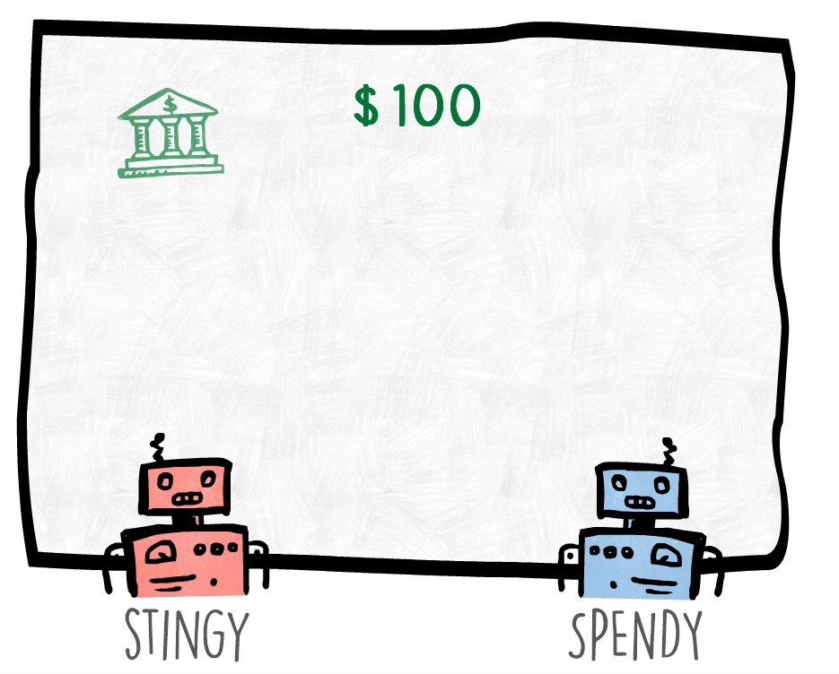
Need for Synchronization
Consider two people, who have access to the same bank account
The first one keeps adding money, the second one keeps spending money
Initial balance is $100

Slide 65
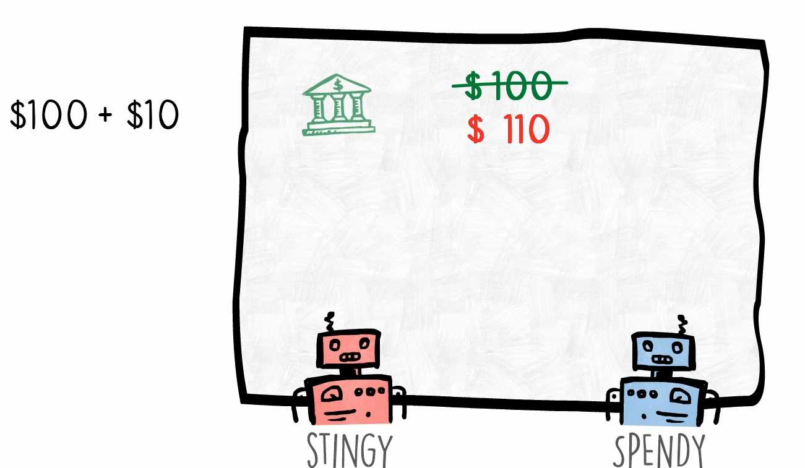
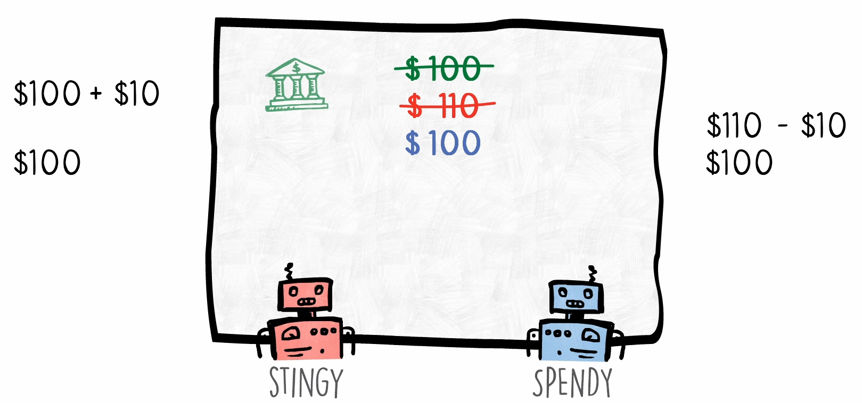
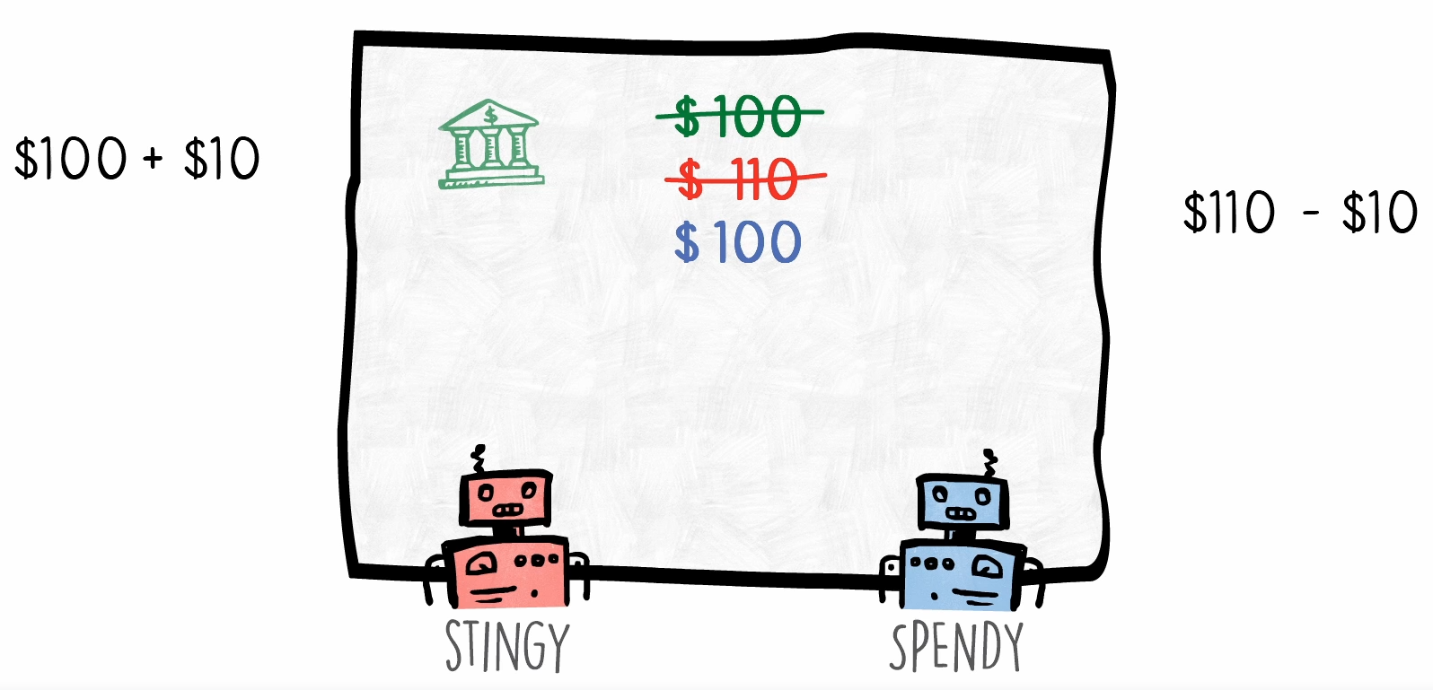
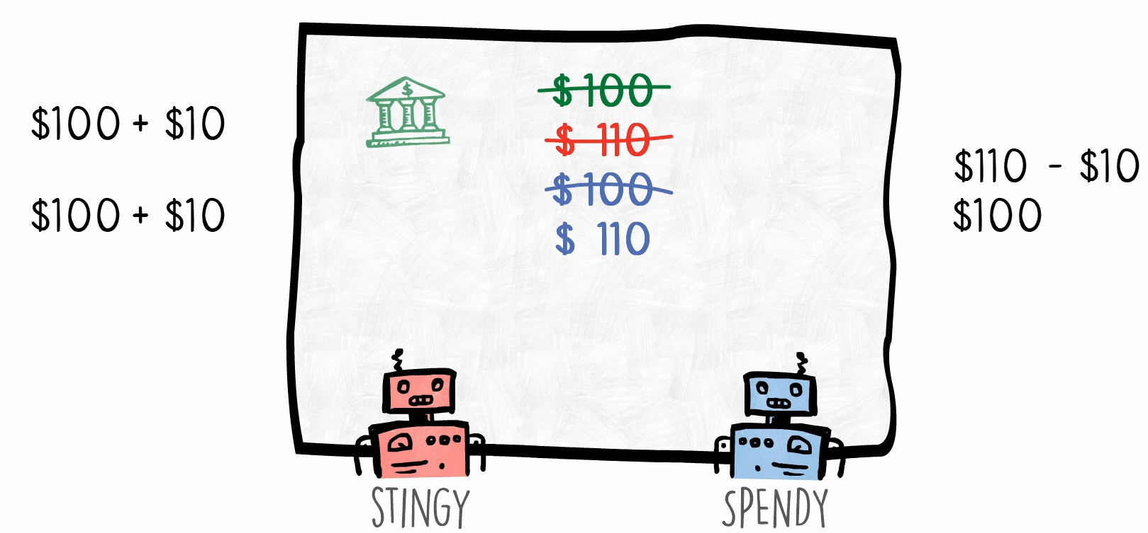
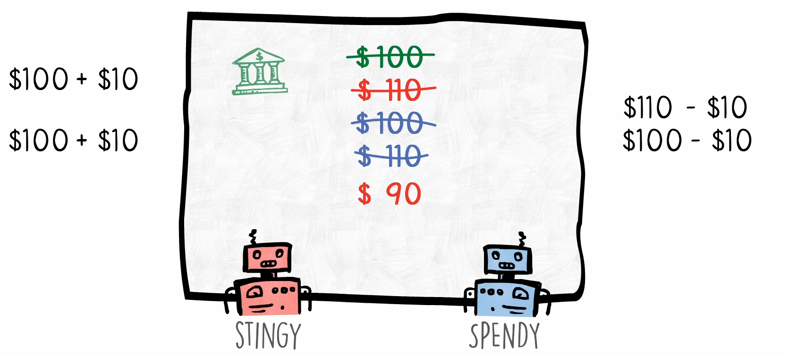
Need for Synchronization
Step 1: Stingy adds $10
Step 2: Spendy immediately spends the $10
Step 3: Both read the balance
Step 4: Both update balance (WRONG! Final balance should be $100)

Slide 66
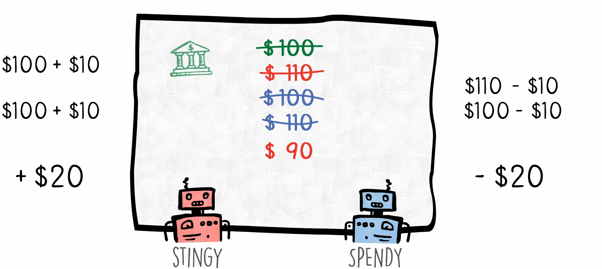
Race Condition
Because $20 were added and spent, the final balance should have been $100
But it is not – this is called as race condition

Slide 67
Race Condition Example: C:\lectures\CDAC\DAC\stingy_spendy.py
import time
from threading import Thread
class StingySpendy:
money = 100
def stingy(self):
for i in range(50000000):
self.money += 10
print("Stingy Done")
def spendy(self):
for i in range(50000000):
self.money -= 10
print("Spendy Done")
ss = StingySpendy()
Thread(target=ss.stingy, args=()).start()
Thread(target=ss.spendy, args=()).start()
time.sleep(5)
print("Money in the end", ss.money)

Slide 68
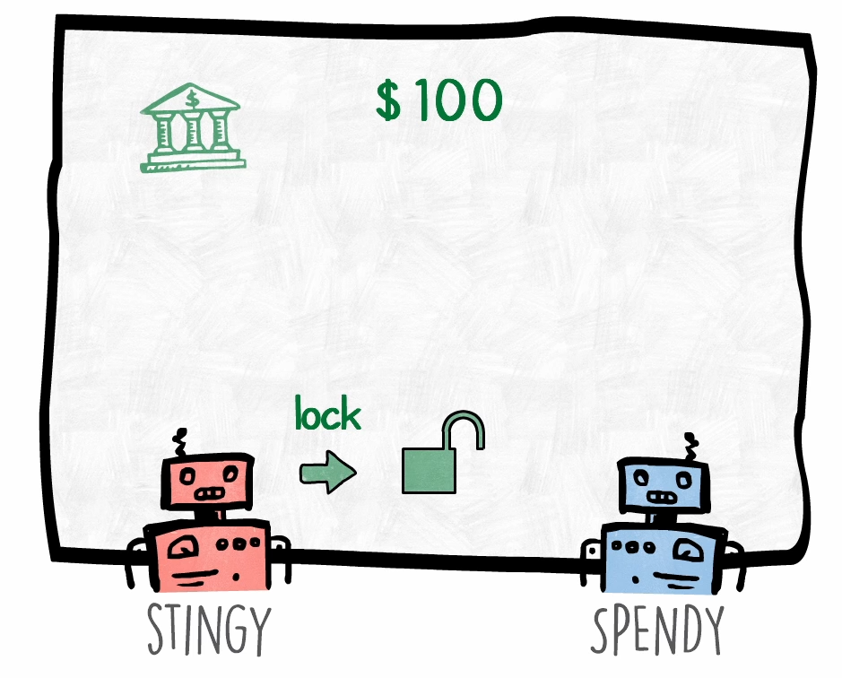
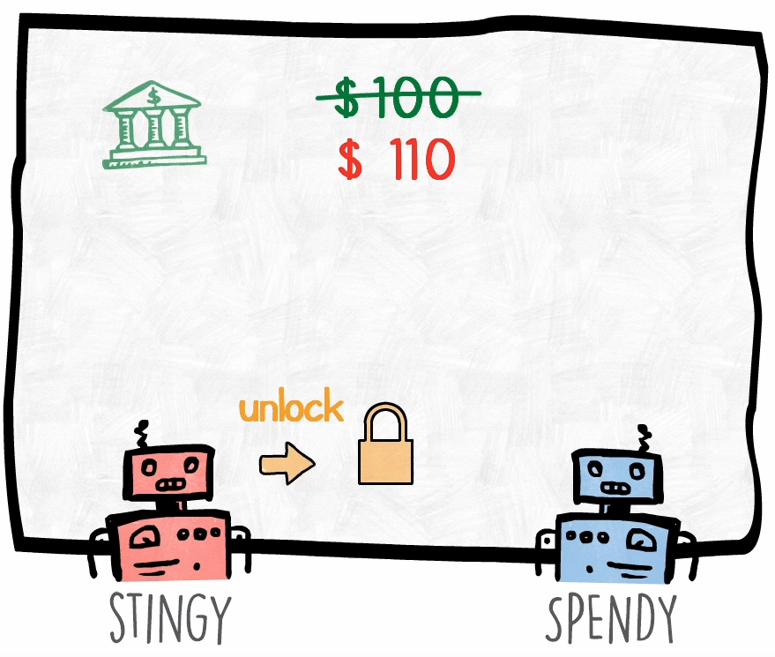
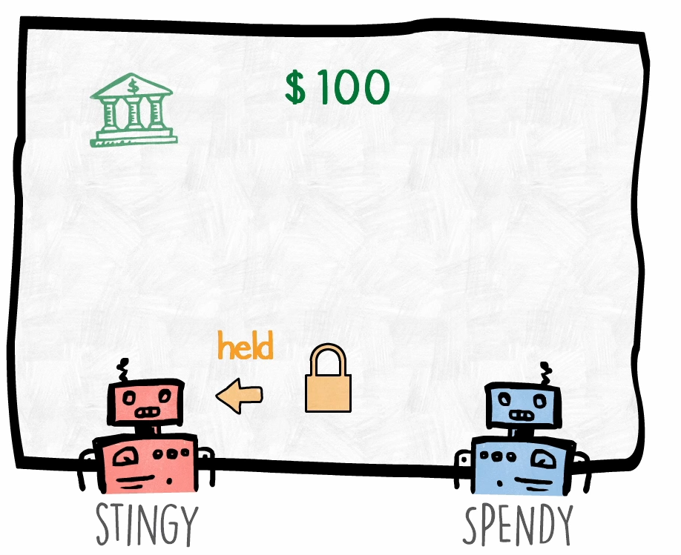
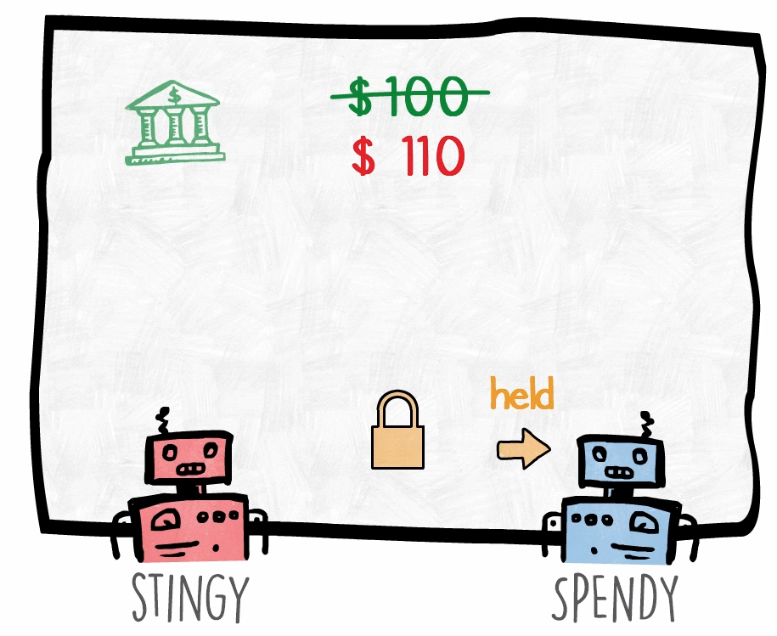
Using Mutex
Step 1: Stingy would ask for a lock (mutex)
Step 2: Since no one is holding the mutex, Stingy gets it
Step 3: Stingy thread updates balance and releases mutex
Step 4: Now if Spendy locks it, updated balance will be seen

Slide 69
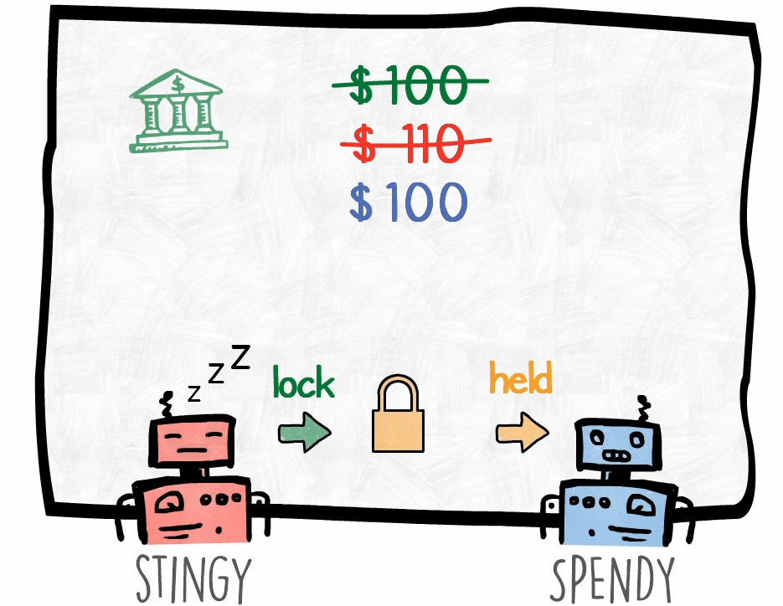
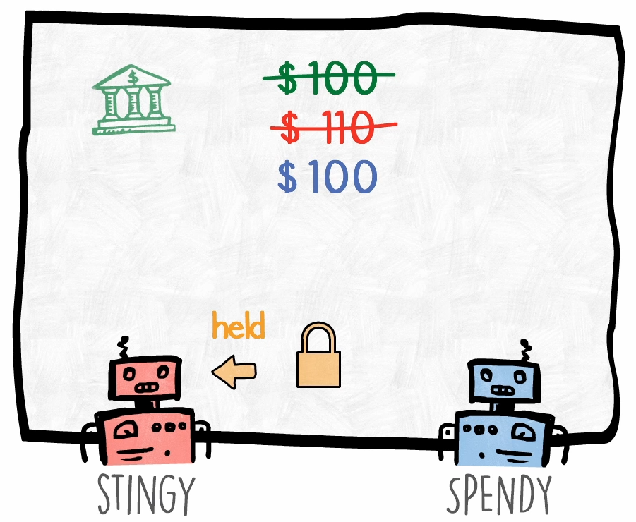
What if a Locked Resource is Wanted by Another Thread?
Currently, the spendy thread is holding mutex on the balance and stingy again wants the mutex … It must go to sleep and wait till spendy releases it!

Slide 70
Mutex Example: C:\lectures\CDAC\DAC\stingy_spendy_mutex.py
import time
from threading import Thread, Lock
class StingySpendy:
money = 100
mutex = Lock()
def stingy(self):
for i in range(5000000):
self.mutex.acquire()
self.money += 10
self.mutex.release()
print("Stingy Done")
def spendy(self):
for i in range(5000000):
self.mutex.acquire()
self.money -= 10
self.mutex.release()
print("Spendy Done")
ss = StingySpendy()
Thread(target=ss.stingy, args=()).start()
Thread(target=ss.spendy, args=()).start()
time.sleep(5)
print("Money in the end", ss.money)

Slide 71
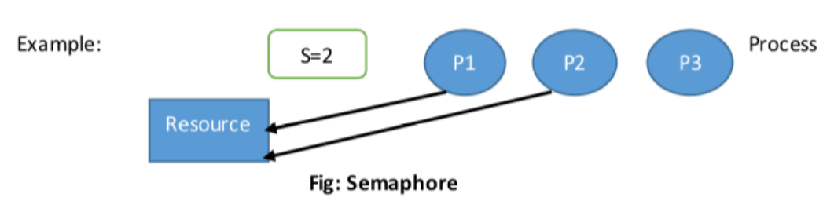
Semaphore versus Mutex
Semaphore is a signaling mechanism.
Semaphore restricts the number of simultaneous users of a shared resource up to a maximum number.
Threads can request access to the resource (decrementing the semaphore) and can signal that they have finished using the resource (incrementing the semaphore).
It allows number of thread to access shared resources.

Slide 72
Main Differences
Mutex is locking mechanism ownership method. Semaphore is a signaling mechanism.
Mutex works in user space but semaphore works in kernel space.
Mutex is generally binary, semaphore is an integer.

Slide 73
Producer-Consumer Problem
Producer-consumer problem is also known as the bounded-buffer problem
Two processes share a common fixed-size buffer
The producer puts information in
The consumer takes it out
If the producer wants to write more information but the buffer is full, the producer goes to sleep and is woken up when the consumer removes one or more items from the buffer
If the consumer wants to read more information but the buffer is empty, the consumer goes to sleep and is woken up when the producer adds one or more items to the buffer

